Slide 1
TI Platform tutorial
Author: ChiaLien,Hsu

Slide 2
outline
Overview
Building flow on itsdk for am335x-evm
Tisdk boot from sdcard
Tisdk boot from tftp
Building flow on ubuntu for beaglebone black
BBB boot from sdcard
BBB boot from tftp
Conclusion
Reference

Slide 3
Overview
The difference between TI am335x and STM spear series shows on partition table shows follows
TI am335x | STM spear series
MLO , u-boot-spl.bin | Xloader
U-boot.img | uboot
Uboot-spl-os, uEnv.txt | Ubootenv
Kernel | Linux kernel
Filesystem | Root file system
? Or user space | User data

Slide 4
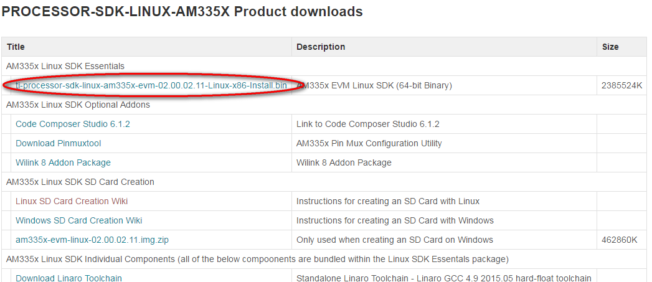
Building flow on tisdk for am335x-evm
Before building process
Pre-Install on ubuntu 14.04
Download the package from website
$ sudo apt-get install git build-essential diffstat texinfo gawk chrpath dos2unix wget unzip g++-multilib socat libsdl1.2-dev xterm doxygen
$ sudo dpkg-reconfigure dash (Select "no" when prompted)
software-dl.ti.com/processor-sdk-linux/esd/AM335X/latest/index_FDS.html (Lastest version 02_00_02_11)

Slide 5
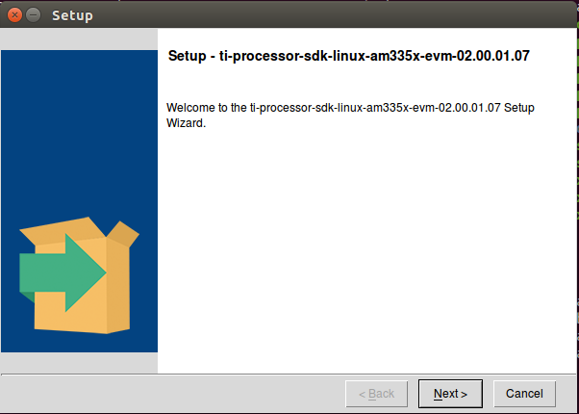

Building flow on tisdk for am335x-evm
Install on ubuntu
$ ./ti-processor-sdk-linux-am335x-evm-02.00.01.07-linux-x86-Install.bin

Slide 6
Building flow on tisdk for am335x-evm
4. install compiler-tool
Mothod one
$ wget http://releases.linaro.org/15.05/components/toolchain/binaries/arm-linux-gnueabihf/gcc-linaro-4.9-2015.05-x86_64_arm-linux-gnueabihf.tar.xz
$ tar -Jxvf gcc-linaro-4.9-2015.05-x86_64_arm-linux-gnueabihf.tar.xz -C $HOME
export PATH=$HOME/gcc-linaro-4.9-2015.05-x86_64_arm-linux-gnueabihf/bin:$PATH

Slide 7

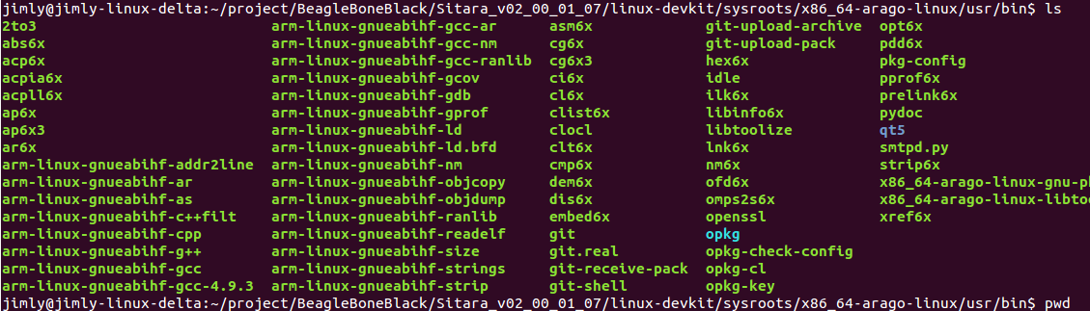
Building flow on tisdk for am335x-evm
Method two:
$ cd linux-devkit/sysroots/x86_64-arago-linux/usr/bin
export PATH=$HOME/gcc-linaro-4.9-2015.05-x86_64_arm-linux-gnueabihf/bin:$PATH

Slide 8
Building flow on tisdk for am335x-evm
quick build on sd card
At {Install_PATH}/bin/
$ ./setup-sdcard.sh

Slide 9
Reference
http://processors.wiki.ti.com/index.php/Processor_SDK_Linux_Software_Developer%E2%80%99s_Guide
http://processors.wiki.ti.com/index.php/Linux_Core_U-Boot_User%27s_Guide
http://processors.wiki.ti.com/index.php?title=Linux_Kernel_Users_Guide&oldid=214181
http://www.linux-mtd.infradead.org/faq/ubifs.html
http://processors.wiki.ti.com/index.php/Put_CRAMFS_Image_to_Flash#NAND_Flash

